Slide 1
CLAS 220 Introduction to Classical Mythology
Homer, Iliad 17-20

Slide 2
Quiz Question
Who kills Patroclus?
Priam
Hector
Achilles
Paris

Slide 3
Quiz Question
2. Which Greek hero protects the body of Patroclus as it lies in the field?
Achilles
Agamemnon
Nestor
Menelaus

Slide 4
Quiz Question
3. Who is Achilles’ mother?
Thetis
Andromache
Hecuba
Hera

Slide 5
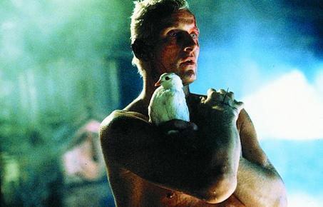
Achilles’ Response
“Now I think
No riches can compare with being alive,
Not even those they say this well-built Ilion
Stored up in peace before the Achaeans came.
Neither could all the Archer’s shrine contains
At rocky Pytho, in the crypt of stone.
A man may come by cattle and sheep in raids;
Tripods he buys, and tawny-headed horses;
But his life’s breath cannot be hunted back
Or be recaptured once it pass his lips.
My mother, Thetis of the silvery feet,
Tells me of two possible destinies
Carrying me toward death: two ways:
If on the one hand I remain to fight
Around Troy town, I lose all hope of home
But gain unfading glory; on the other,
If I sail back to my own land my glory
Fails – but a long life lies ahead for me.”
9.489-50

Slide 6
Achilles’ Great Dilemma
kleos (fame) vs. nostos (homecoming)
If he gets one, he can’t have the other
In Book 1, he withdraws from battle
In Book 9, he seems to choose nostos over kleos
The Greek army suffers defeat after defeat
This section of the poem (Books 13-18) is about how to bring Achilles back to the battle

Slide 7
Achilles’ Return
Achilles’ return to battle and to the social world is part of a chain reaction of deaths.
Patroclus kills Sarpedon.
Hector kills Patroclus.
Achilles kills Hector.
Paris kills Achilles (after the end of the Iliad).

Slide 8
The end of the Iliad
Akhilleus has decided to re-enter the battle
He fights brilliantly, and gets his revenge on Hektor.
But this is not enough, and doesn’t bring Patrklos back.
Book 23: Funeral Games for Patroklos
Book 24: Meeting with Priam
These last two books re-integrate Akhilleus into the human world, in different ways.
Theme of care for the dead – your own dead, and even the dead of your enemies

Slide 9
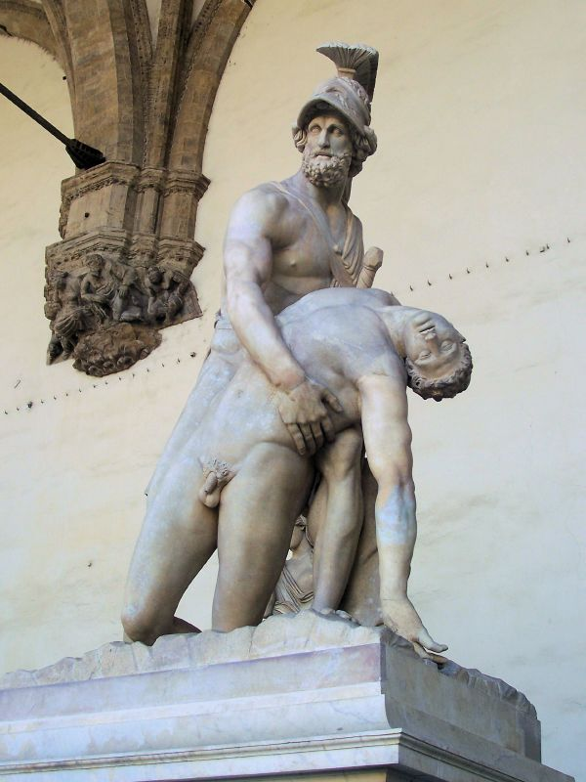
Menelaus over the body of Patroklos
In the midst of the great fight
The eye of Menelaos, dear to the wargod,
Had seen Patroklos brought down by the Trojans.
Now he came forward in his fiery bronze
Through clashing men to stand astride the body –
Protective as a heifer who has dropped
Her first-born calf: she stands above it, lowing,
Never having known birth-pangs before.
So, over dead Patroklos, Menelaos
Planted his heels….

Slide 10
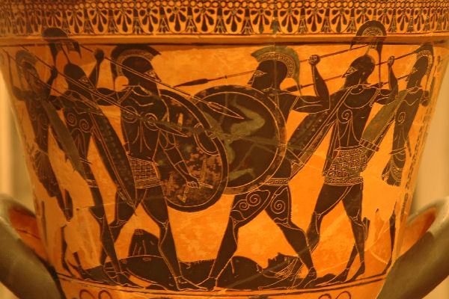
Hector Takes the Armor of Akhilleus/Patroklos
Trojan ranks came on, as Hektor led them.
Backward at last Menelaos turned, and left the body,
Facing about at every step, the way
A bearded lion does when dogs and men
With spears and shouts repel him from a farmyard,
And hatred makes his great heart turn to ice
And he is forced from the cattle pen. Just so,
Forced from Patroklos, tawny Menelaos
Step by step retired… 17.117-125

Slide 11
Zeus Gives Hector Great Power
And Zeus who gathers cloud saw Hektor now
Standing apart, in the hero’s shield and helm,
And nodded, musing over him: “Ah, poor man,
No least presage of death is in your mind,
How near it is, at last. You wear the gear
Of a great prince. Other men blanch before him.
It is his comrade, gentle and strong, you killed,
and stripped his head and shoulders of helm and shield
Without respect. Power for the time being
I will concede to you, as recompense,
For never will Andromakhe receive
Akhilleus’ arms from you on your return.
17.222-33

Slide 12
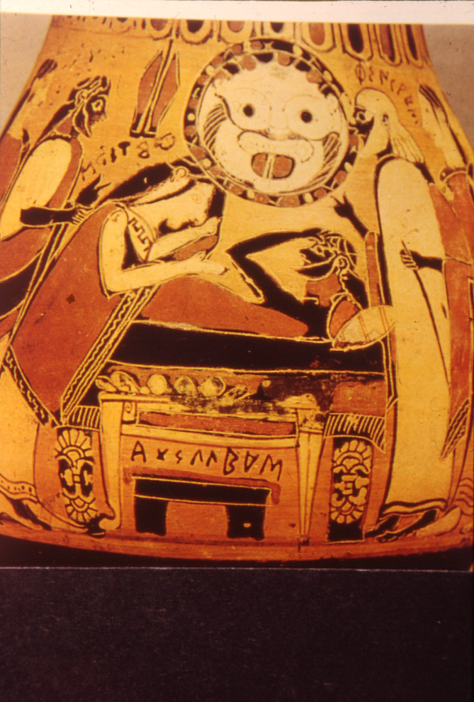
The Grief of Akhilleus
A black stormcloud of pain shrouded Akhilleus,
On his bowed head he scattered dust and ash
In handfuls and befouled his beautiful face,
Letting black ash sift on his fragrant khiton.
Then in the dust he stretched his giant length
And tore his hair with both hands. From the hut
The women who had been spoils of war to him
And to Patroklos flocked in haste around him,
Crying loud in grief. All beat their brests,
And trembling came upon their knees. Antilokhos
Wept where he stood, bending to hold the hero’s
Hands when groaning shook his heart: he feared
The man might use sharp iron to slash his throat.
And now Akhilleus gave a dreadful cry.
18. 25-38

Slide 13
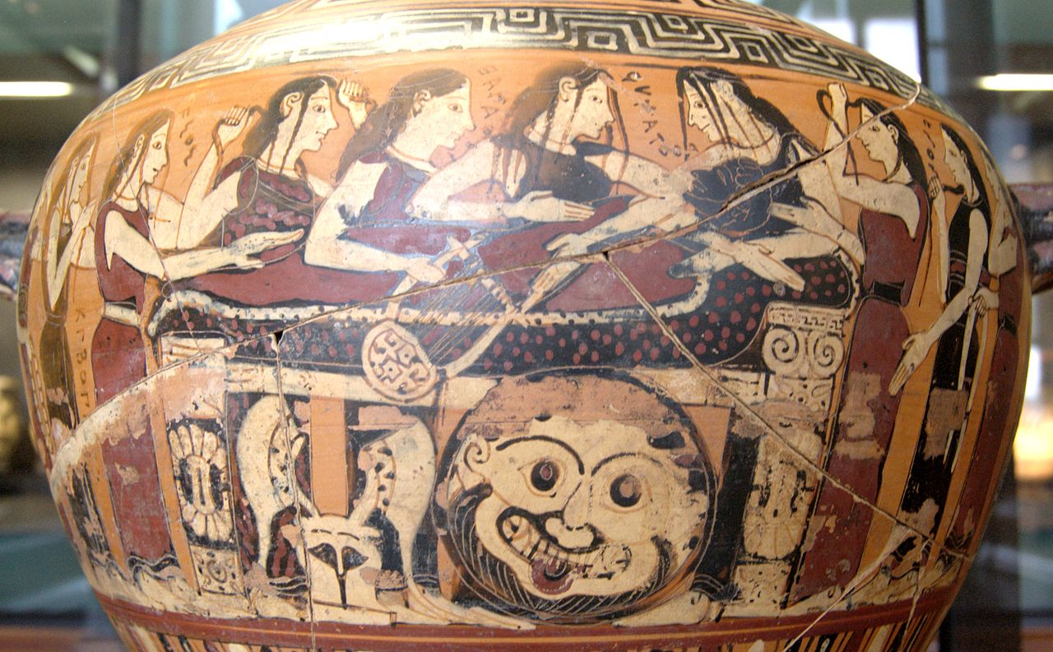
The Grief of Thetis
All these nymphs
Now beat their breasts as Thetis cried in sorrow:
“Sisters, daughters of Nereus, hear and know
How sore my heart is! Now my life is pain
For my great son’s dark destiny I bore
A child flawless and strong beyond all men.
He flourished like a green shoot, and I brought him
To manhood like a blossoming orchard tree,
Only to send him in the ships to Ilion
To war with Trojans. Now I shall never see him
Entering Peleus’ hall, his home, again.
But even while he lives, beholding sunlight,
Suffering is his lot. I have no power
To help him, though I go to him. Even so,
I’ll visit my dear child and learn what sorrow
Came to him while he held aloof from war.”
18. 55-70

Slide 14
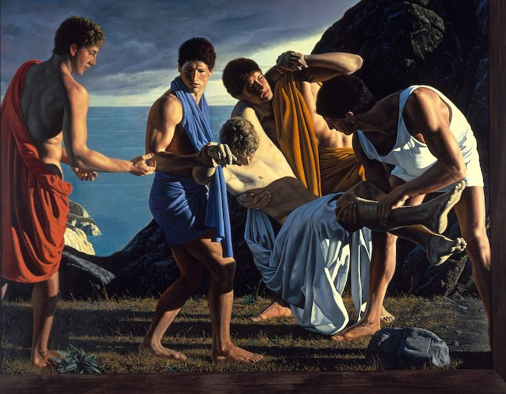
Achilles Roars
Moving from parapet
To moat, without a nod for the Akhaians,
Keaping clear, in deference to his mother,
He halted and gave tongue. … The great sound
Shocked the Trojans
Into tumult, as a trumpet blown
By a savage foe shocks an encircled town,
So harsh and clarion was Akhilleus’ cry.
The hearts of mean quailed, hearing that brazen voice….
Now the Akhaians leapt at the chance
To bear Patroklos’ body out of range.
They placed it on his bed,
And old companions there with brimming eyes
Surrounded him. Into their midst Akhilleus
Came then, and he wept hot tears to see
His faithful friend, torn by the sharp spearhead,
Lying cold upon his cot. Alas,
The man he sent to war with team and chariot
He could not welcome back alive.
18. 247-273

Slide 15
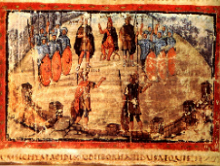
After the death of Patroklos: Trojans Plan
Now for the good of all Polydamas spoke among them:
"Think well of our alternatives, my friends.
What I say is, retire upon the town,
instead of camping on the field till dawn
here by the ships. We are a long way
from our stone wall. As long as that man raged
at royal Agamemnon, we could fight
the Akhaians with advantage. I was happy
to spend last night so near the beach and think
of capturing ships today. Now, though, I fear
the son of Peleus to my very marrow!
There are no bounds to the passion of that man.
18. 290-301

Slide 16
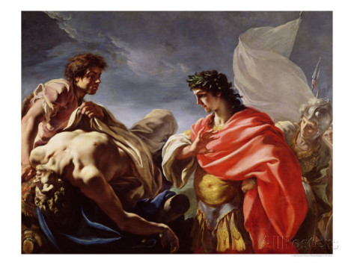
After the death of Patroklos: Greeks Lament
Now with a groan
Achilles cried out to the Myrmidons: "Ah, god,
what empty prophecy I made that day
to cheer Menoitios in his megaron!
I promised him his honored son, brought back
to Orpoeis, as pillager of Ilion
bearing his share of spoils.
But Zeus will not fulfill what men design,
not all of it. Both he and I were destined
to stain the same earth dark red here at Tory.
No going home for me; no welcome there
from Peleus, master of horse, or from my mother,
Thetis. Here the earth will hold me under.
Therefore, as I must follow you into the grave,
I will not give you burial, Patroklos,
until I carry back the gear and head
of him who killed you, noble friend.
Before your funeral pyre I'll cut the throats
of twelve resplendent children of the Trojans --
that is my murdering fury at your death... 18.376-395

Slide 17
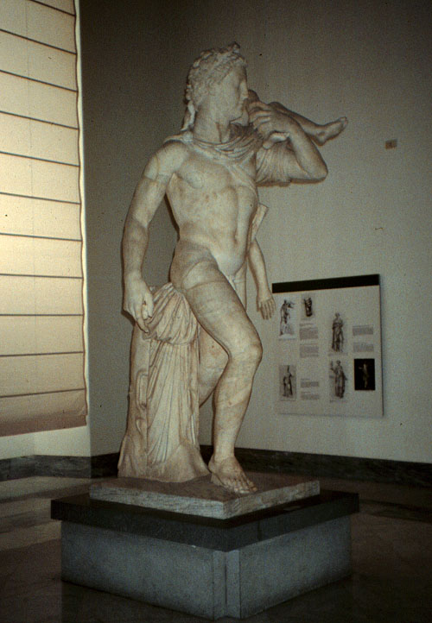
Patroklos Mourned
With this Akhilleus called the company
To place over the campfire a big tripod
And bathe Patroklos of his clotted blood.
Setting tripod and caldron on the blaze
They poured it full, and fed the fire beneath,
And flames licked around the belly of the vessel
Until the water warmed and bubbled up
In the bright bronze. They bathed him then, and took
Sweet oil for his annointing, laying nard
In the open wounds; and on his bed they placed him,
Covering him with fine linen, head to foot,
And a white shroud over it. So all that night
Beside Akhilleus the great runner,
The Myrmidons held mourning for Patroklos.
18. 401-415

Slide 18
Quiz Question
4. Who makes new armor for Achilles?
Ares
Thetis
Nestor
Hephaestus

Slide 19
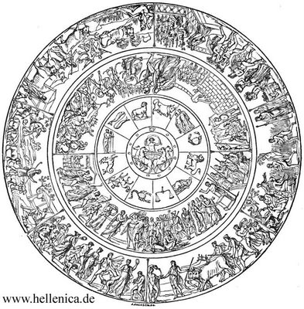
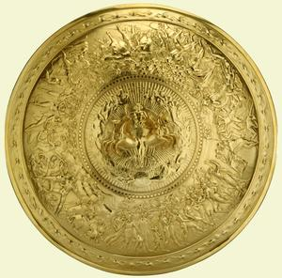
The Shield of Achilles – Ekphrasis: the description of a work of visual art in a work of literature

Slide 20
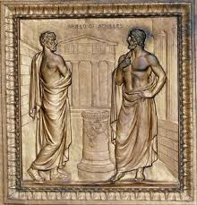
On the Shield: City of Peace
A crowd, then, in a market place, and there
Two men at odds over satisfaction owed
For a murder done: one claimed that all was paid,
And publicly declared it; his opponent
Turned the reparation down, and both
Demanded a verdict from an arbiter,
As people clamored in support of each,
And criers restrained the crowd.
18. 570-578

Slide 21
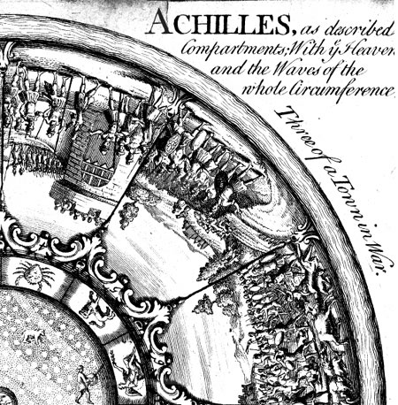
On the Shield: City of War

Slide 22
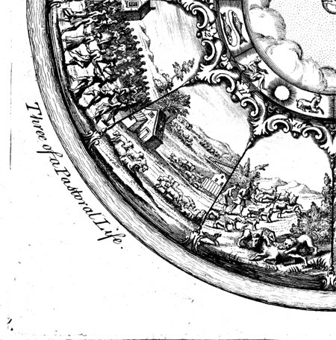
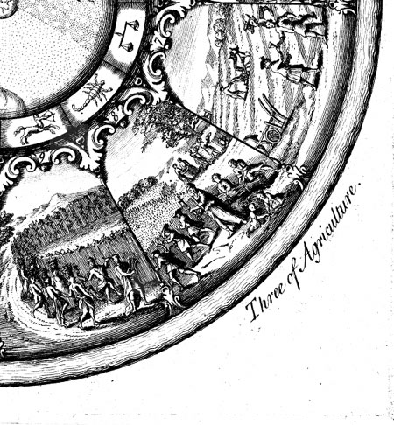
On the shield Daily Life (farming, festivals)

Slide 23
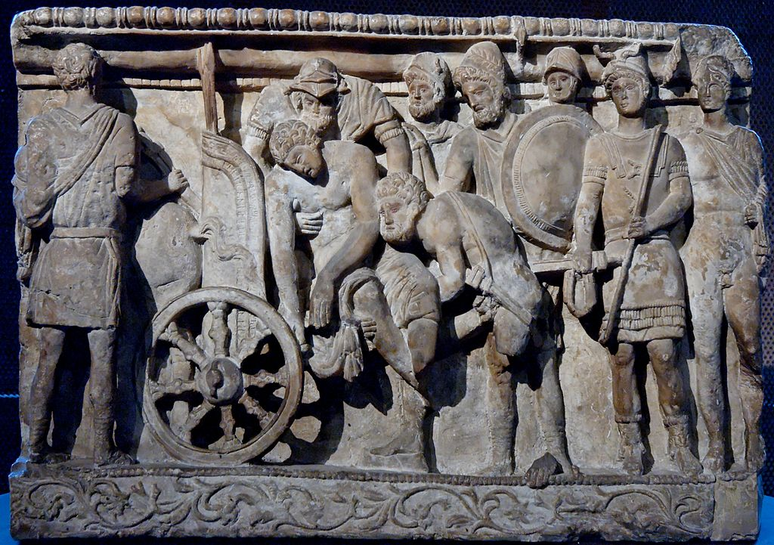
Care for Patroklos’ Body
Only, I feel the dread that while I fight
Black carrion flies may settle on Patroklos’
Wounds, where the spearheads marked him, and I fear
They may breed maggots to defile the corpse,
Now life is torn from it. His flesh may rot.
But silvery-footed Thetis answered: “Child,
You must not let that prey on you. I’ll find
A way to shield him from the black fly hordes
That eat the bodies of men killed in a battle.
Though he should lie unburied a long year,
His flesh will be intact and firm.
19. 27-38

Slide 24
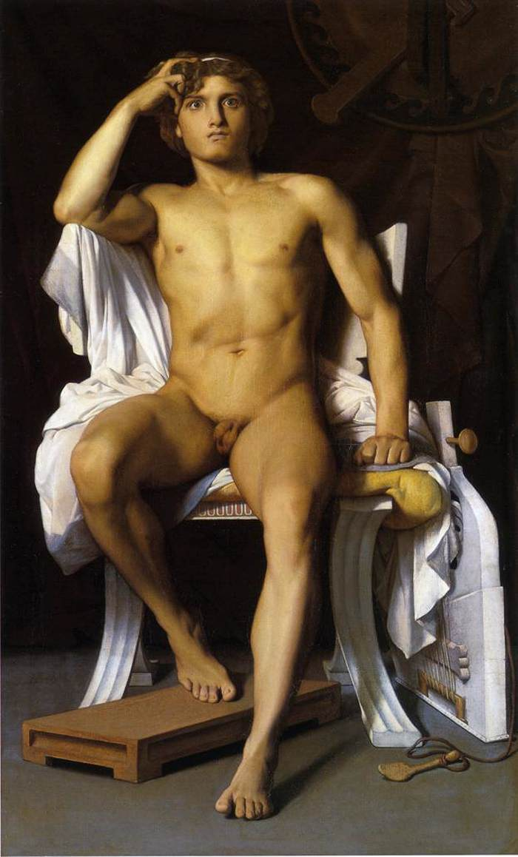
Akhilleus Abandons his Rage
“Agamemnon, was it better for us
In any way, when we were sore at heart,
To waste ourselves in strife over a girl?
If only Artemis had shot her down
Among the ships on the day I made her mine
After I took Lyrnessos!
Fewer Akhaians would have died hard
at enemy hands, while I abstained in anger –
Hektor’s gain, the Trojan’s gain. Akhaians
Years hence will remember our high words,
Mine and yours. But now we can forget them,
And, as we must, forego our passion. Aye,
By heaven, I drop my anger now!
(19.64-76)

Slide 25
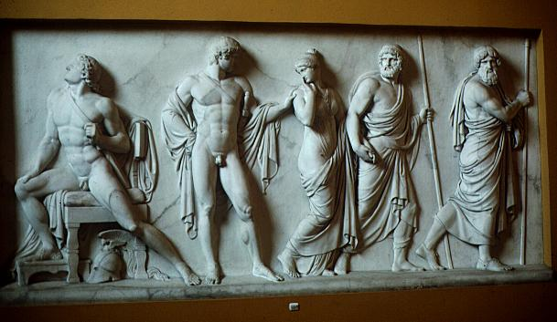
Agamemnon Replies
Rouse for war,
Send in your troops! I here repeat my offer
Of all that Odysseus promised yesterday!
19.158-160
Achilles:
Lord Marshall Agamemnon, make the gifts
If you are keen to – gifts are due; or keep them.
It is for you to say. Let us recover
Joy of battle soon, that’s all!
19. 165-68

Slide 26
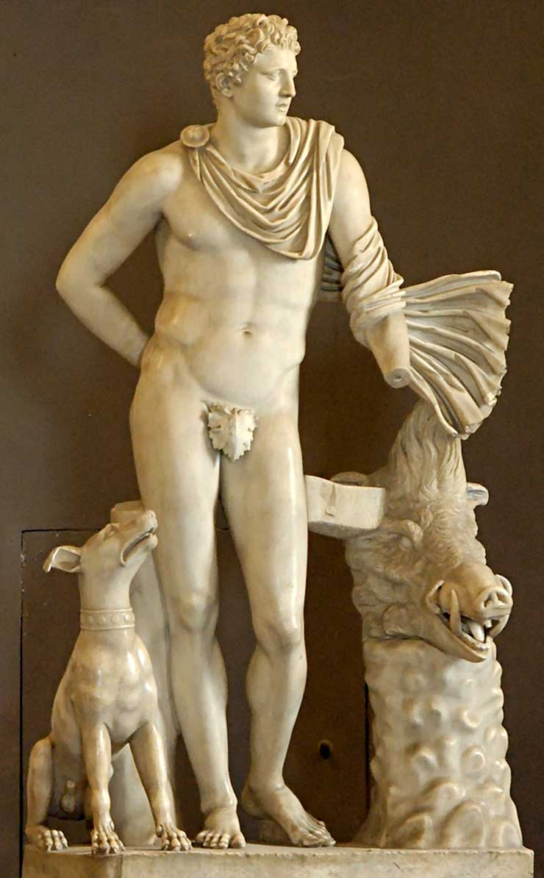
Meleager (review)
Phoenix, Achilles’ mentor, tries to persuade him through the telling of a myth, that of the Calydonian boar.
This boar (or rather the honor of keeping its head), was the subject of a war between Meleager’s people, the Aitolians, and their rivals, the Kouretes.
The hero Meleager was leading the battle, but was offended by his mother, and so he withdrew to spend time with his wife (Kleopatre).
A series of people beg him to come back to the fight:
The old men (with prizes), his father, sisters, mother, friends, all to no avail.
Then his wife begs him to fight, and he does, but at great cost.

Slide 27
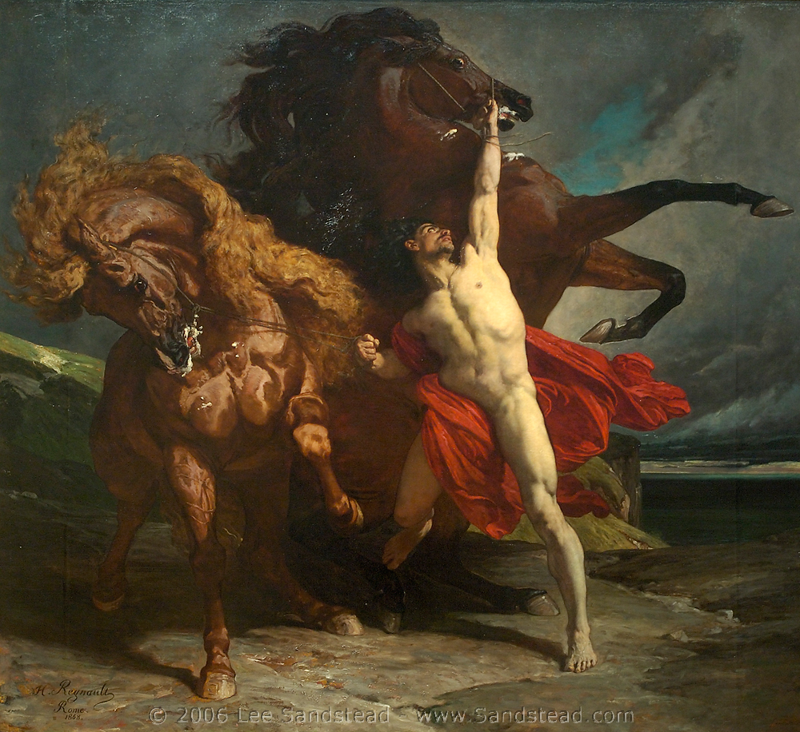
The Horse (Xanthus) Speaks
Yes, we shall save you,
This time, too, Akhilleus in your strength!
And yet the day of your destruction comes,
And it is nearer. We are not the cause,
But rather a great god is, and mighty Fate.
Nor was it by our sloth or sluggishness
The Trojans stripped Patroklos of his armor.
No, the magnificent god that Leto bore
Killed him in action, and gave Hektor glory….
On this, the furies put a stop to Xanthos’ voice.
In anger and gloom Akhilleus said to him:
“Xanthos, why prophesy my death? No need.
What is in store for me I know, know well:
To die here, far away from my dear father,
My mother, too. No matter. All that matters
Is that I shall not call a halt today
Till I have made the Trojans sick of war!”
19.452-472

Slide 28
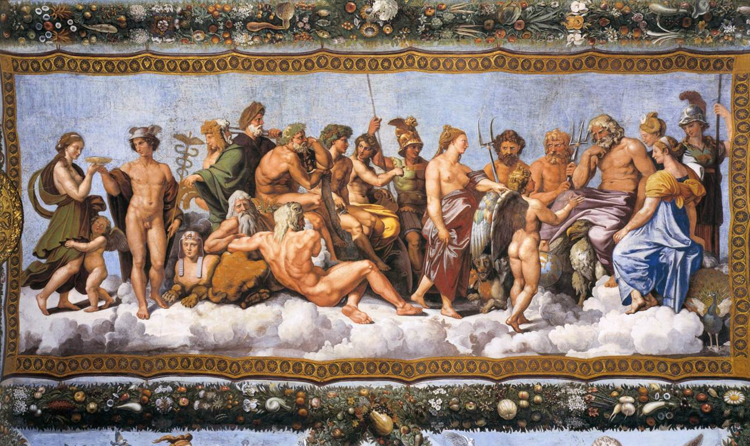
The Gods Return to Battle
Zeus:
“But you others,
Go into action, side with men of Troy
Or with Akhaians, as each has a mind to.
Suppose Akhilleus takes the Trojans on
Alone: not for a minute will they hold him.
In times past they used to shake to see him,
And now he’s mad with rage for his friend’s death,
I fear he’ll break the wall down, sack the town,
Before the time has come for it.” (20.27-35)
So the gods in bliss
Roused the contenders, hurled them into war,
And broke in massive strife among themselves. (20.60-62)

Slide 29
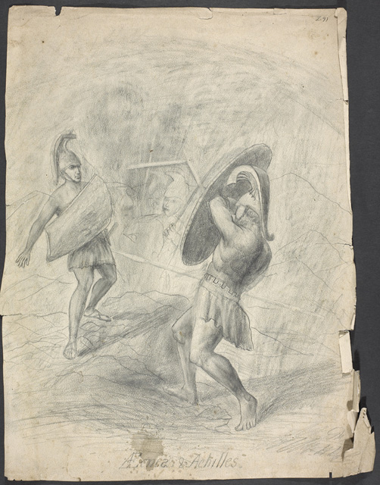
Akhilleus and Aineias
“Royal Peleus’ son you are said to be,
And the salt-sea goddess Thetis was your mother.
My own claim is that I was born the son
Of Ankhises, the hero, and my mother
Is Aphrodite. Of these four, one pair
Will mourn a son today…”
20.237-42

Slide 30
Quiz Question
5. What happens to Patroclus’ body once it is returned to the Greek camp?
It is quickly buried with full honors
It is neglected, and quickly decays
It is desecrated by Agamemnon and Menelaus
It remains miraculously undecayed

Slide 31
Quiz Question
Who is the god of wine?
Demeter
Apollo
Hermes
Dionysus

Slide 32
Quiz Question
2. Which of the following is an area of interest to Artemis?
hunting
menstruation
childbirth
All of the above

Slide 33
Quiz Question
3. Which hero is the main subject of Philostratus’ Heroikos?
Priam
Achilles
Protesilaus
Ajax

Slide 34
Quiz Question
4. Which of the following is NOT a necessary characteristic of a Greek hero?
extremeness
Divine antagonism
untimeliness
goodness

Slide 35
Quiz Question
5. Which animal is typically sacrificed to a hero?
ox
pig
goat
ram

